Slide 1

Investigate the maintenance of pneumatic and hydraulic systems
Learning Outcome 4
Akbar q – Mechatronics Engineering
Notes:
1

Slide 2

Why Maintenance Matters
Case Study: Hydraulic failure in an injection moulding machine causing £85k in downtime.
Statistics: 70% of hydraulic failures stem from fluid contamination (ISO 4406)
Safety Implications: OSHA incident report on ruptured pneumatic line injury.
The Cost of Neglect
2
Notes:
2

Slide 3

Why Maintenance Matters
Life Extension: Proper maintenance can triple component lifespan
Energy Savings: 15-30% reduction in compressed air costs with leak repairs
Downtime Prevention: Predictive maintenance reduces unplanned outages by 45%
Maintenance ROI
3
Notes:
3

Slide 4

Why Maintenance Matters
PSR 2000 (Pressure Systems Safety Regulations) requirements
PUWER 98 (Provision and Use of Work Equipment Regulations) compliance
ISO 4414/4413 standards for fluid power systems
Regulatory Landscape
4
Notes:
4

Slide 5

Advanced Fault Diagnosis
Symptom-Based Troubleshooting
Root Cause Analyses
Predictive Maintenance
Maintenance Planning
Performance Optimization
5
Notes:
5

Slide 6

A. Symptom-Based Troubleshooting
Pneumatic Fault Matrix:
Symptom | Likely Causes | Diagnostic Tools
Slow actuator movement | Air leaks Undersized piping Clogged filters | Ultrasonic leak detector, pressure gauge
Erratic valve operation | Moisture contamination Worn seals Electrical faults | Dew point meter, multimeter
6

Slide 7
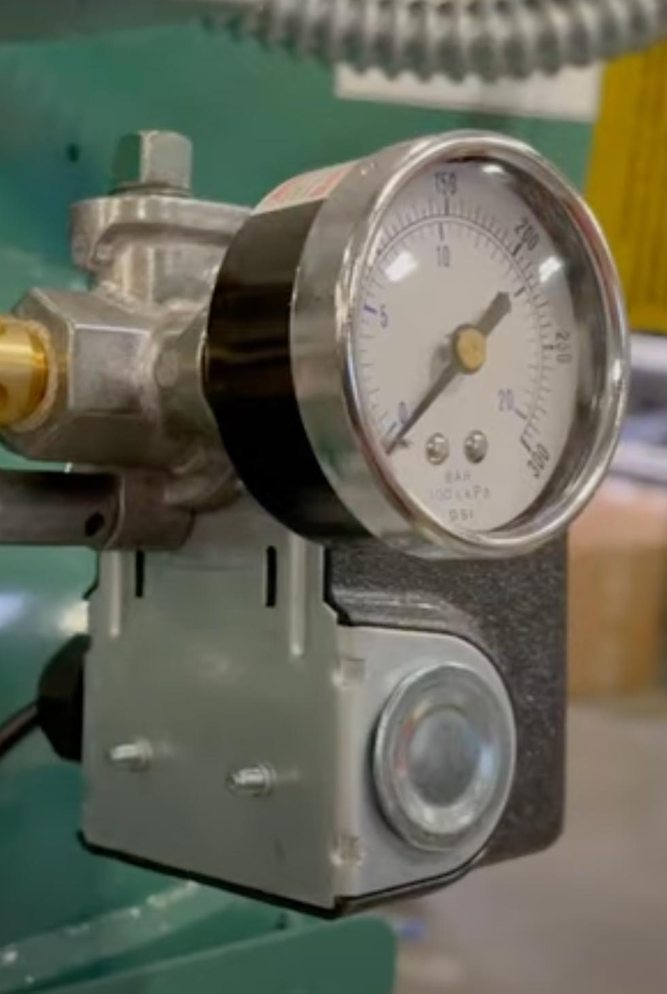
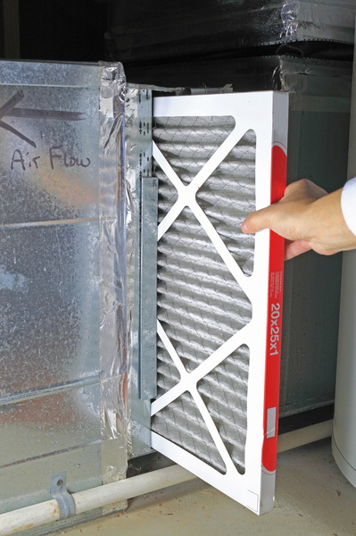
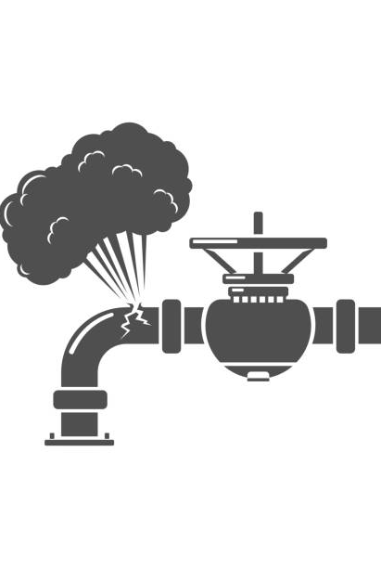
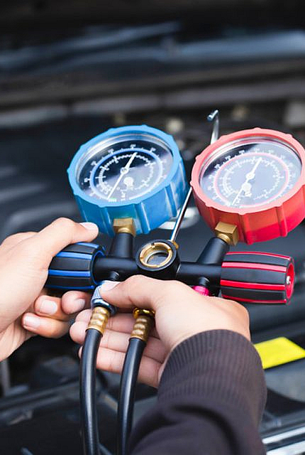
Pneumatic Systems
7
Notes:
7

Slide 8
A. Symptom-Based Troubleshooting
Hydraulic Fault Matrix:
Symptom | Likely Causes | Diagnostic Tools
Overheating system | Clogged cooler High viscosity oil Pump wear | IR thermometer, oil analysis
Noisy pump operation | Cavitation Aeration Misalignment | Stethoscope, vibration analyzer
8

Slide 9
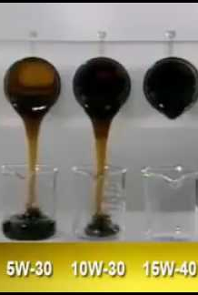
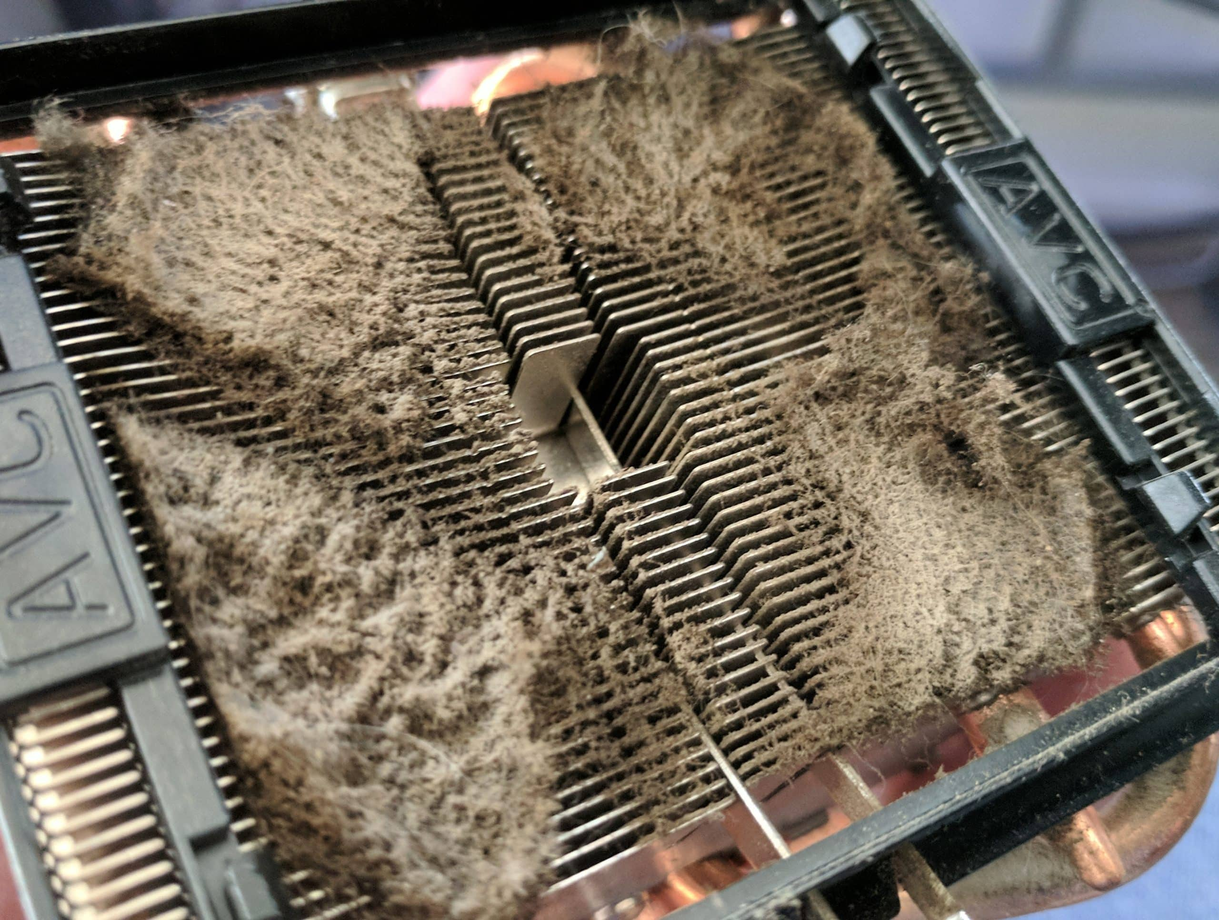

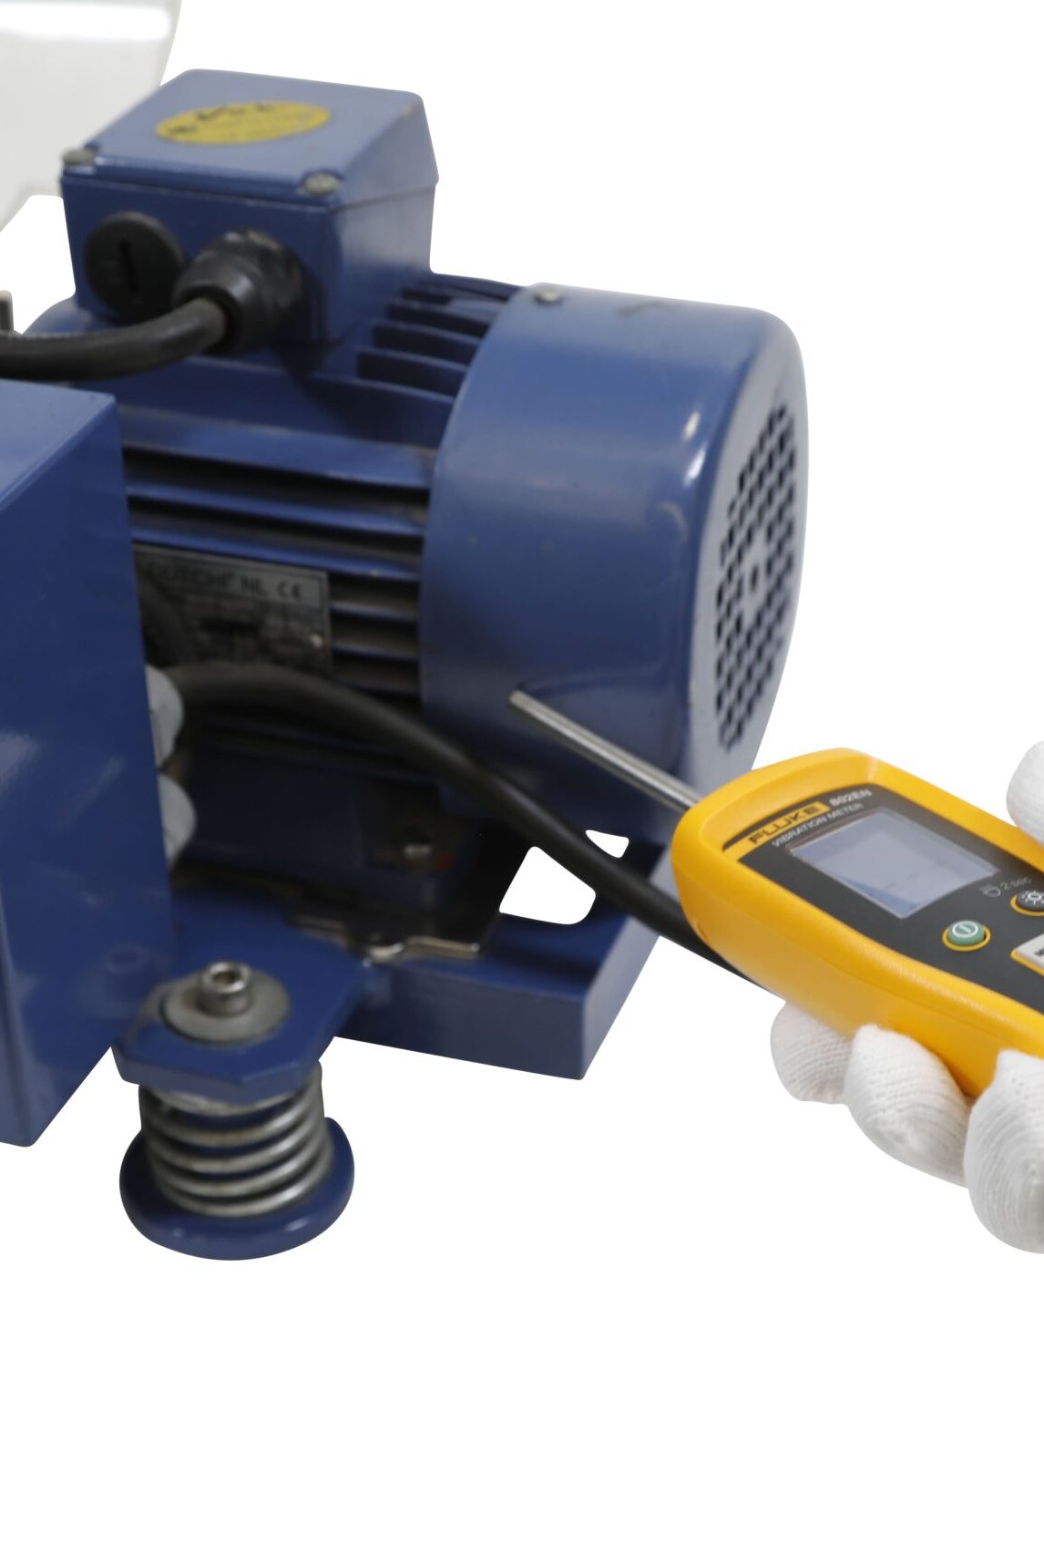
Hydraulic Systems
9
Notes:
9

Slide 10

Root Cause Analysis
^{No.}
1
Hydraulic cylinder "creeps" under load
Construct Fishbone diagram (Machine, Method, Material, Environment)
^{No.}
2
^{No.}
3
Perform 5 Whys analysis
10
Notes:
10

Slide 11

Fishbone
Visual tool to identify root causes of system failures (e.g., hydraulic leaks, pneumatic pressure drops).
11
Notes:
11

Slide 12

Structure:
Head: Problem statement (e.g., "Hydraulic cylinder creep").
Bones: Categories of causes (traditionally the 6 Ms):
Machine (e.g., pump wear, valve sticking).
Method (e.g., incorrect maintenance procedures).
Material (e.g., contaminated fluid, degraded seals).
Manpower (e.g., training gaps).
Measurement (e.g., faulty pressure sensors).
Environment (e.g., temperature fluctuations).
20XX
CONFERENCE PRESENTATION
12
Notes:
12

Slide 13
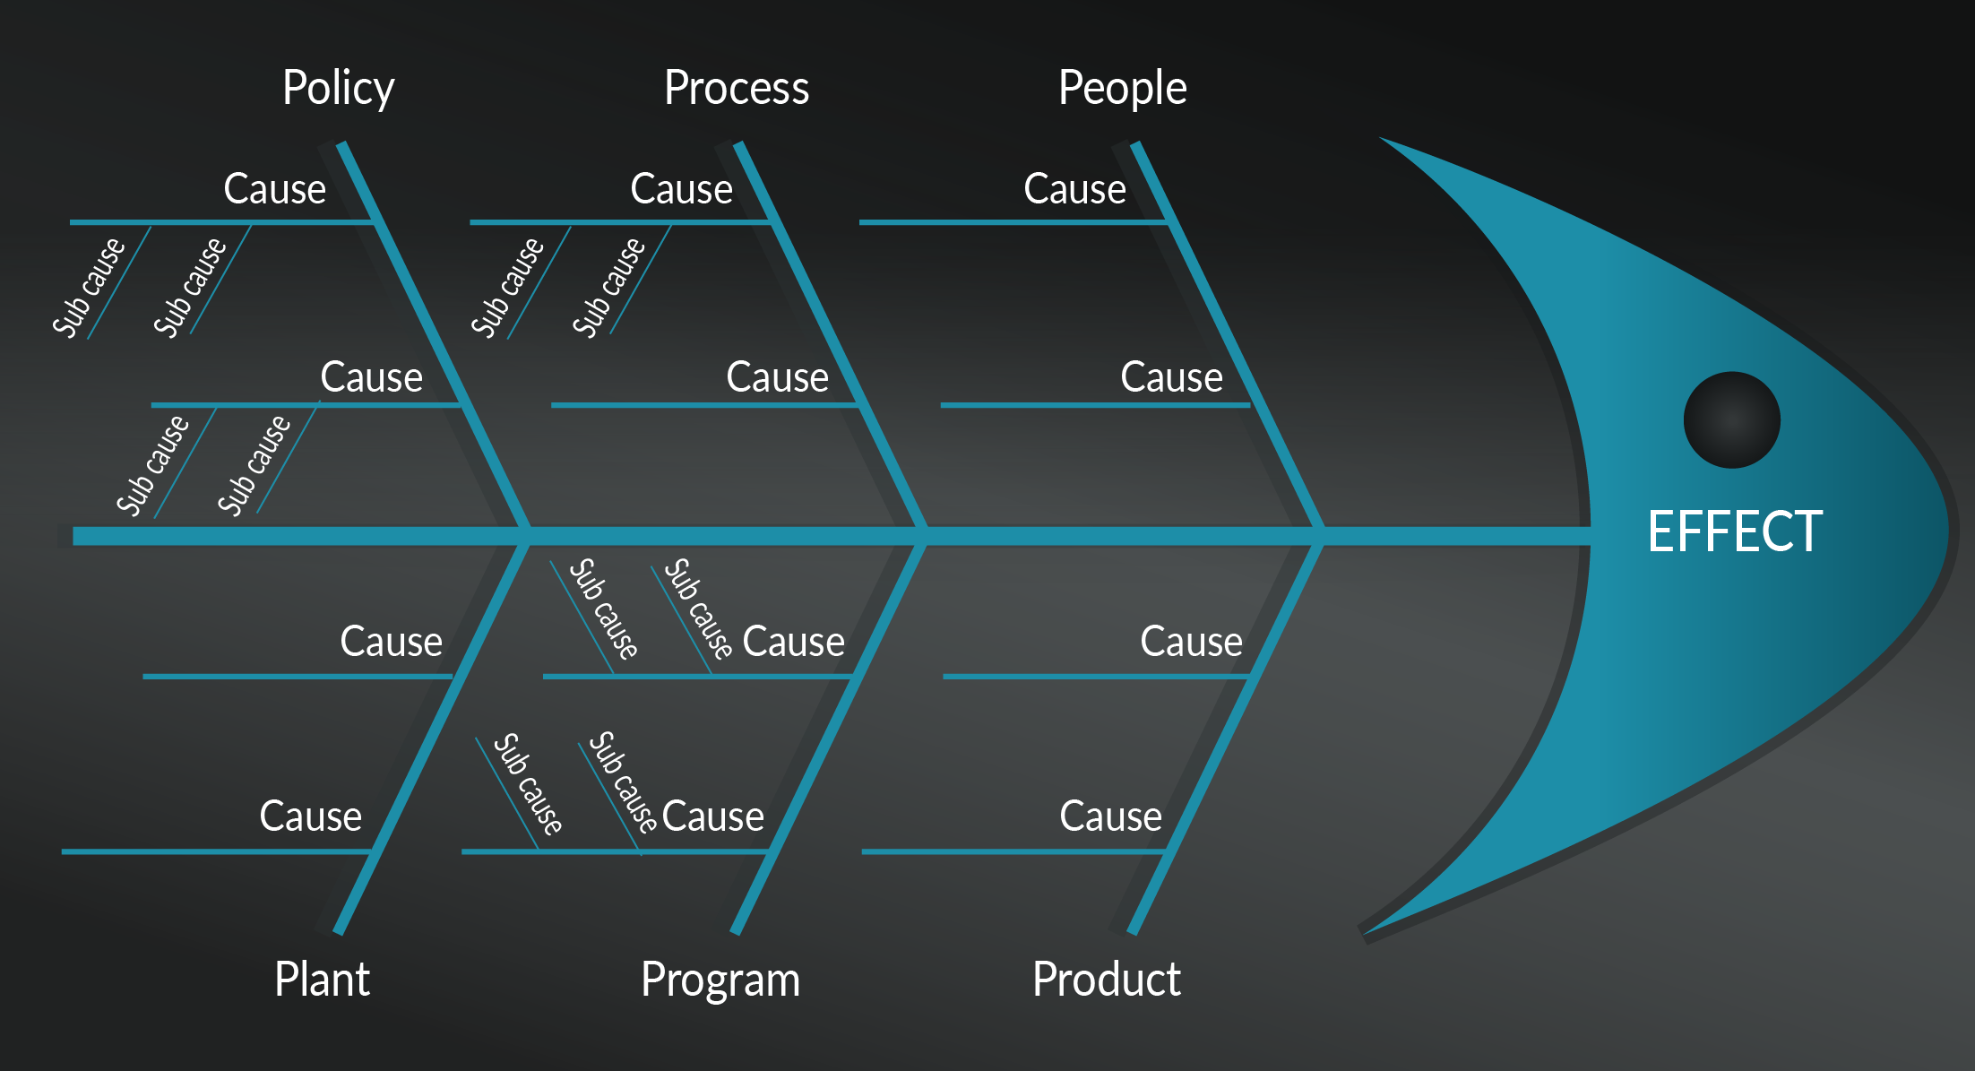
Notes:
13

Slide 14
Steps to Create a Fishbone Diagram
Define the Problem: Be specific (e.g., "Pneumatic actuator slow to respond").
Identify Categories: Use the 6 Ms or customize (e.g., add "Software" for automated systems).
Brainstorm Causes: For each category, ask "Why?" (e.g., "Why is the actuator slow?" → "Low air pressure" → "Clogged filter").
Prioritize Causes: Use data (e.g., oil analysis reports) to validate hypotheses.
Test Solutions: Address root causes (e.g., replace filters, recalibrate sensors).
14
Notes:
14

Slide 15

https://app.smartdraw.com/
Draw a Fishbone/Cause Effect Diagram Here
15
Notes:
15

Slide 16
C. Example: Hydraulic System Overheating
Machine: Pump cavitation due to worn bearings.
Material: High-viscosity oil incompatible with operating temps.
Method: Incorrect cooler maintenance schedule.
Environment: Poor ventilation in equipment room.
16
Notes:
16

Slide 17
Integrating Standards and Fishbone Diagrams into Maintenance Plans
A. Proactive Maintenance Strategies
Predictive Maintenance:
  Use vibration analysis (for pumps) and oil sampling (ISO 4406) to detect issues early 27.
Condition-Based Monitoring:
  Install IoT sensors for real-time pressure/flow tracking.
B. Documentation & Continuous Improvement
Fault Logs: Record findings from Fishbone analyses in a CMMS (Computerized Maintenance Management System) 11.
Design Updates: Modify components (e.g., upgrade seals) based on recurring root causes.
17
Notes:
17

Slide 18
Sample Actuator Creeping
18
Notes:
18

Slide 19
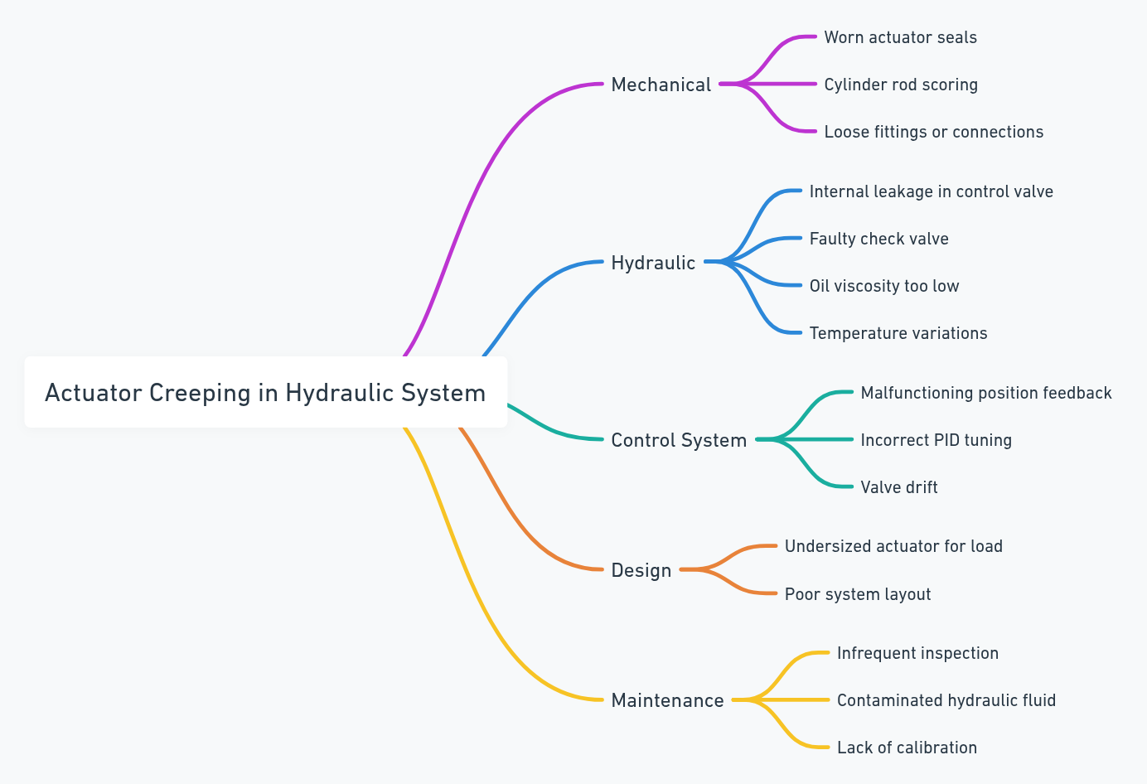
Notes:
19

Slide 20
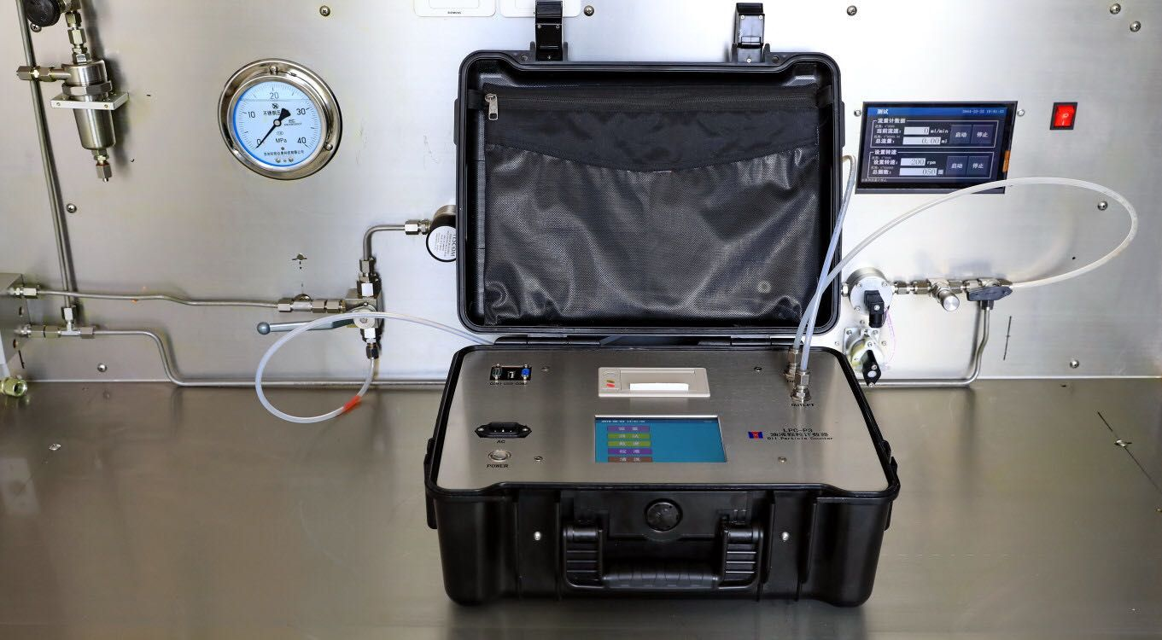
Modern Diagnostic Tools
Oil Particle Counting (ISO 4406 cleanliness codes)
Vibration Analysis for pump/motor bearing wear
Thermal Imaging for heat buildup in valves
20
Notes:
20

Slide 21
Predictive Maintenance Strategies
Condition Monitoring Techniques
Technique | What It Detects | Implementation Cost
Vibration analysis | Imbalance, misalignment, bearing wear | £££
Oil spectroscopy | Metal particles, additive depletion | ££
Air leak detection | Compressed air losses | £
21

Slide 22

IoT-Enabled Maintenance
^{No.}
1
Wireless sensor networks
Cloud-based analytics
^{No.}
2
Festo's IoT implementation can potentially reduce downtime by 37%
^{No.}
3
22
Notes:
22

Slide 23

Maintenance Interval Optimization
Weibull Analysis for determining optimal replacement schedules
P-F Interval Concept: Identifying the point between potential failure and functional failure
20XX
CONFERENCE PRESENTATION
23
Notes:
23

Slide 24
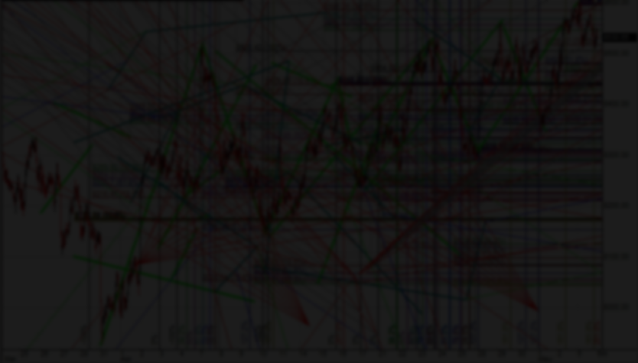
Weibull Analysis is a statistical method used to analyze time-to-failure data and determine the reliability and failure patterns of components or systems.
24
Notes:
24

Slide 25
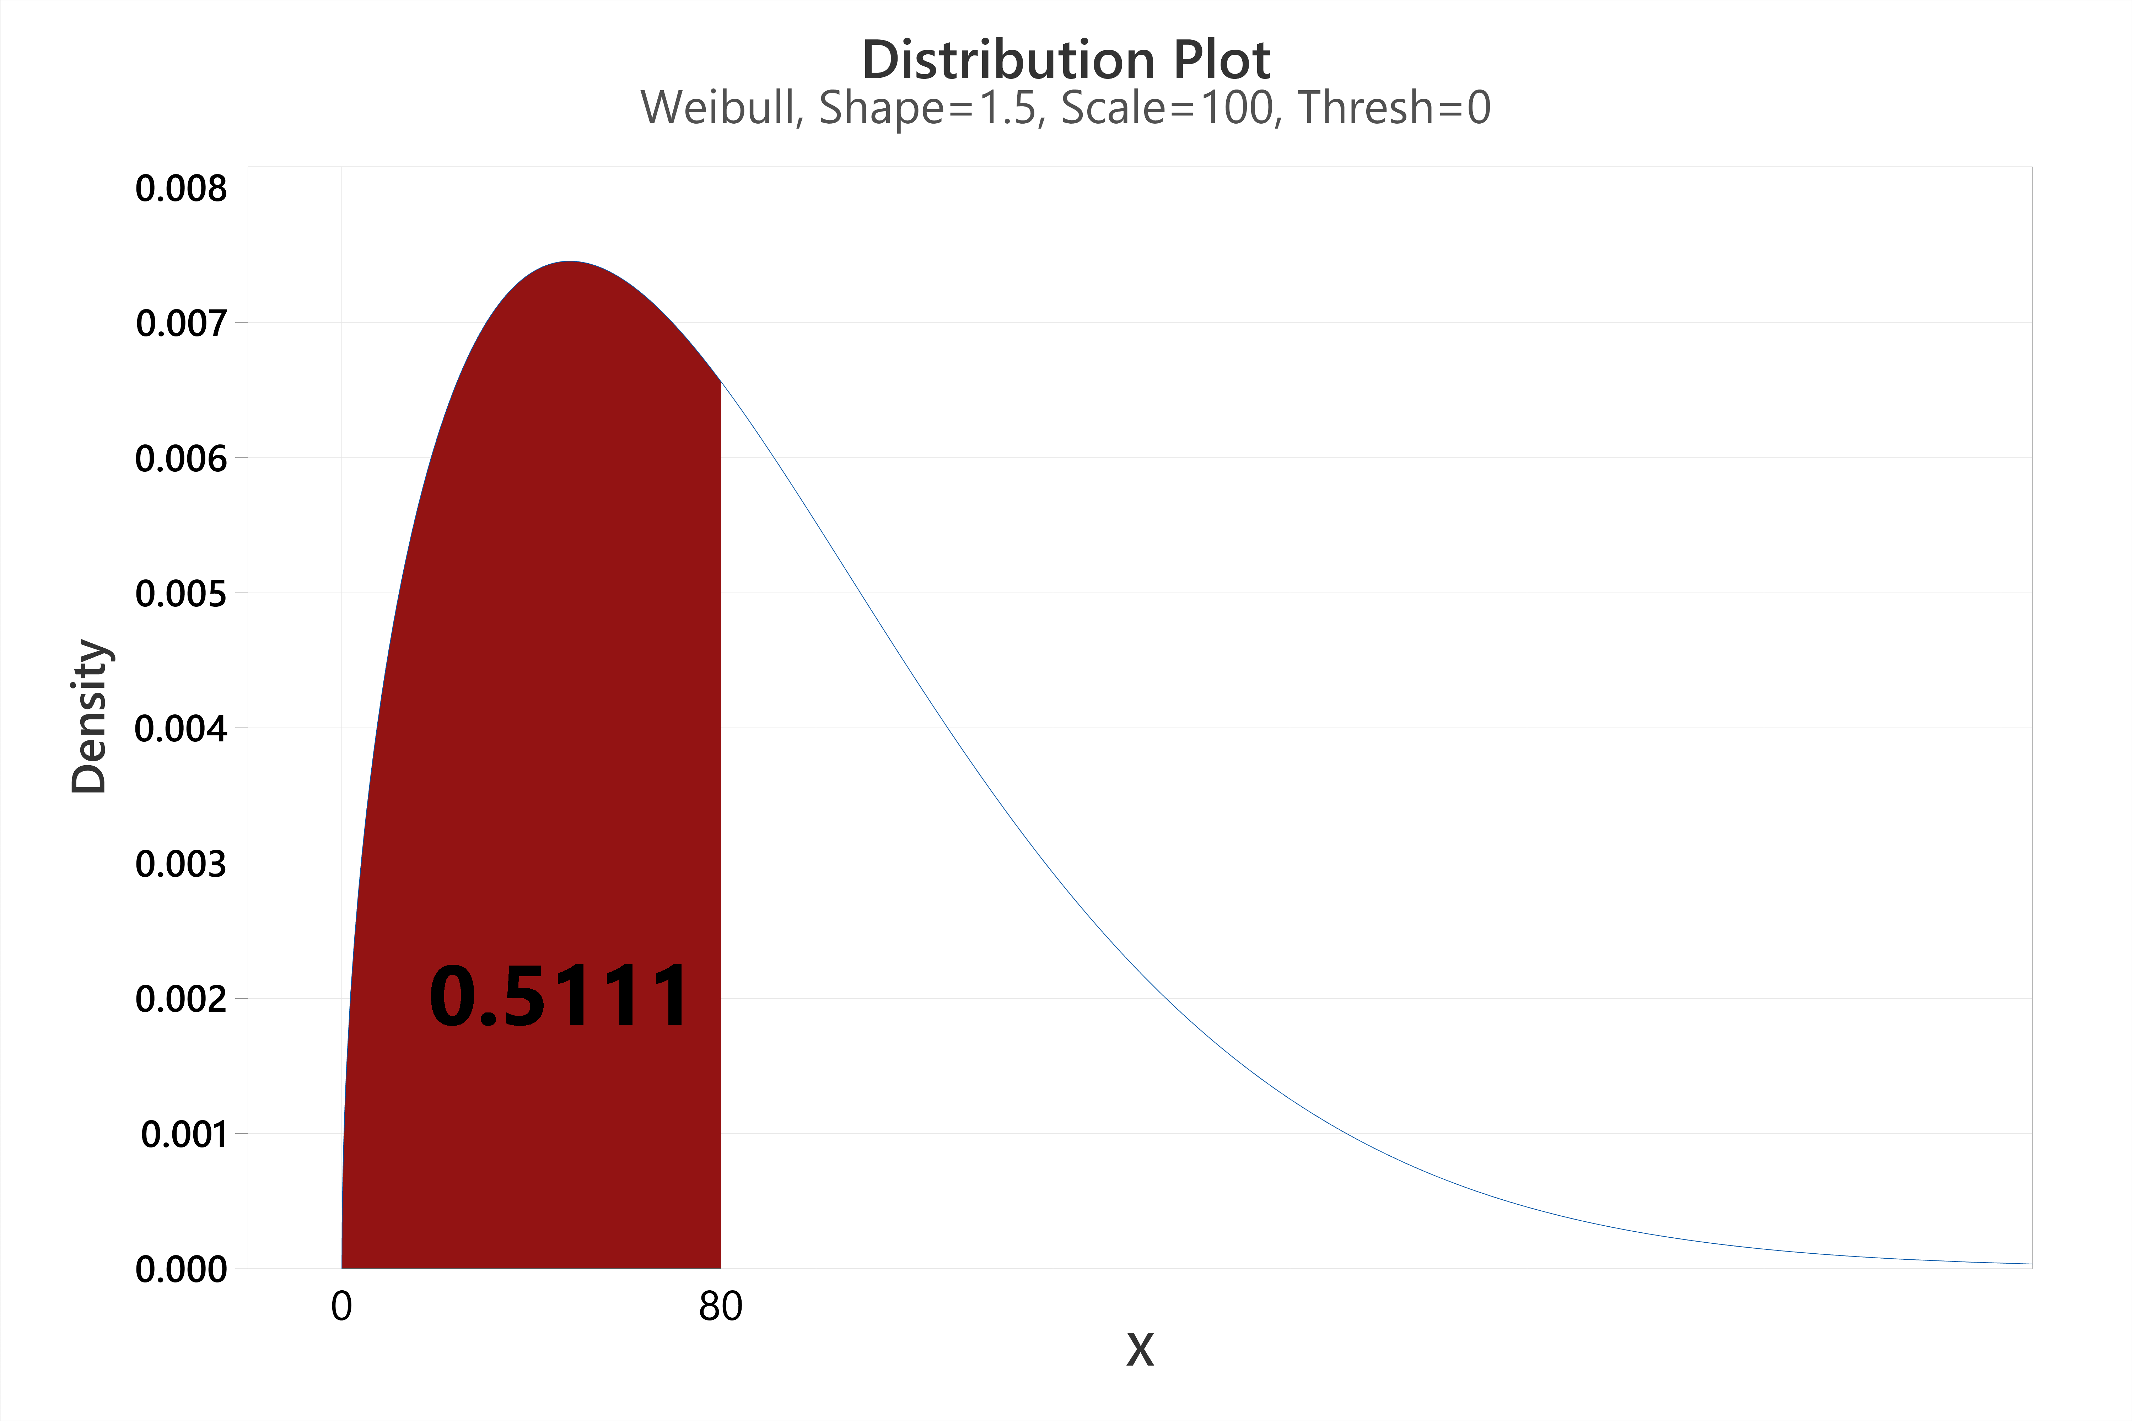
Notes:
25

Slide 26
Used to model how likely a hydraulic pump, valve, seal, or actuator is to fail over time.
It helps identify whether failures are:
Infant mortality (early failures due to manufacturing defects),
Random (due to unpredictable external factors),
Wear-out (due to aging or usage).
26
Notes:
26

Slide 27
The P-F Interval is the time between the point when a potential failure (P) is first detectable and the point of functional failure (F)—when the system can no longer perform as required.
27
Notes:
27

Slide 28
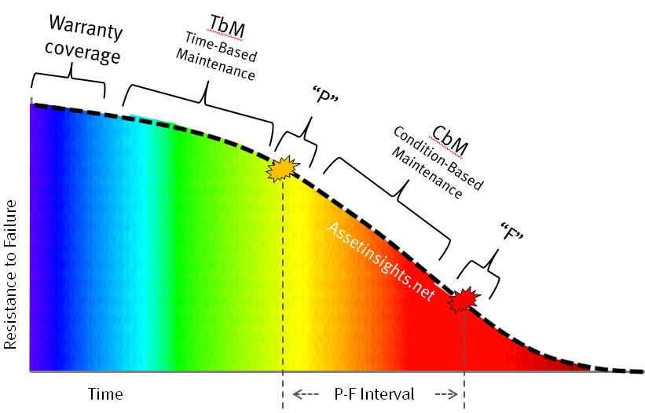
Notes:
28

Slide 29
Helps determine how frequently condition monitoring should be performed.
Ensures failures are caught early enough to take preventive action without unplanned downtime.
A slow increase in actuator response time may be detectable (point P) before complete loss of motion due to internal leakage (point F).
29
Notes:
29

Slide 30

Hands-On Maintenance Planning
Developing Your Maintenance Plan
Lubrication Management
Safety-Centric Maintenance
30
Notes:
30

Slide 31

Inspection Tasks
Daily: Check reservoir levels, inspect for leaks
Weekly: Test safety valves, check filter indicators
Monthly: Oil analysis, actuator stroke testing
Preventive Tasks
Quarterly: Replace desiccant in air dryers
Annually: Flush hydraulic systems, recalibrate sensors
Predictive Tasks
Continuous: Vibration monitoring on critical pumps
As needed: Thermographic surveys during peak loads
31
Notes:
31

Slide 32
Best Practices:
Pneumatics: ISO VG 32 oil in lubricators (1 drop/10m³)
Hydraulics: Follow OEM viscosity recommendations
Common Mistakes:
Over-lubrication of pneumatic cylinders causing valve sticking
Mixing incompatible greases in hydraulic systems
32
Notes:
32

Slide 33
Lockout/Tagout (LOTO) procedures for fluid power systems
Safe depressurization techniques
PPE requirements for different maintenance tasks
33
Notes:
33

Slide 34

Performance Optimization
34
Notes:
34

Slide 35

A. Energy Efficiency Upgrades
Pneumatics:
Fixing leaks (1mm hole = £700/year in wasted air)
Right-sizing actuators to minimize air consumption
Hydraulics:
Variable displacement pumps vs. fixed pumps
Heat recovery systems
35
Notes:
35

Slide 36
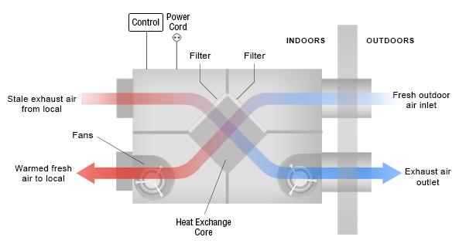
Notes:
36

Slide 37
B. Reliability Engineering
FMEA Exercise: Students analyze a hydraulic power unit
Design Improvements:
Quick-disconnect test points for easier diagnostics
Modular valve manifolds for faster replacement
37
Notes:
37

Slide 38
Software-Assisted Maintenance
CMMS (Computerized Maintenance Management Systems) demo
Augmented Reality for maintenance guidance
38
Notes:
38

Slide 39
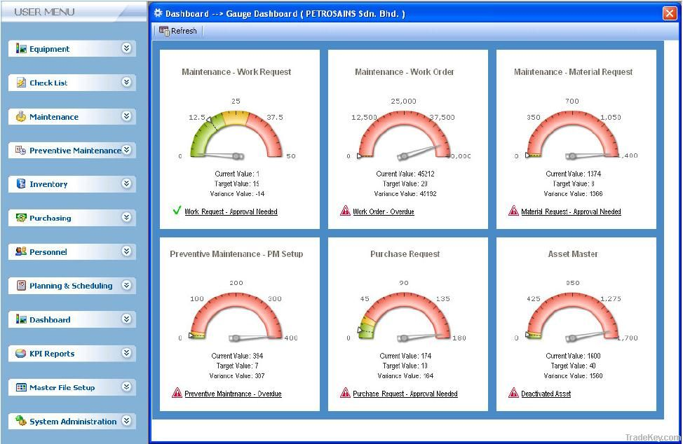
Notes:
39

Slide 40

Key Industry Standards for Compliance
40
Notes:
40

Slide 41

ISO 4413 (Hydraulics) & ISO 4414 (Pneumatics)
Scope: Covers design, installation, and maintenance of stationary and mobile fluid power systems.
Safety Provisions: Integrates EU Machinery Directive 2006/42/EC requirements, including risk assessments (ISO 14121-1) and safety control systems (ISO 13849-1).
Maintenance Requirements:
Regular inspection of pressure vessels and piping.
Fluid cleanliness standards (ISO 4406 for hydraulic oil particulate counts).
Lubrication schedules for actuators and valves.
41
Notes:
41

Slide 42
Pressure Systems Safety Regulations (PSR 2000)
Key Requirements:
Written schemes of examination for pressure systems.
Certification of inspectors.
Record-keeping of maintenance and testing.
42
Notes:
42

Slide 43
OSHA & ANSI Standards (U.S.) 7
Lockout/Tagout (29 CFR 1910.147): Mandates energy isolation during maintenance.
NFPA 79: Electrical and fluid power safety for industrial machinery.
ANSI/B11 Series: Guidelines for hydraulic press maintenance.
43
Notes:
43

Slide 44
EN 982 & EN 983 (EU)
Withdrawn but historically influenced ISO standards with stricter safety protocols for hydraulic/pneumatic systems.
44
Notes:
44

Slide 45
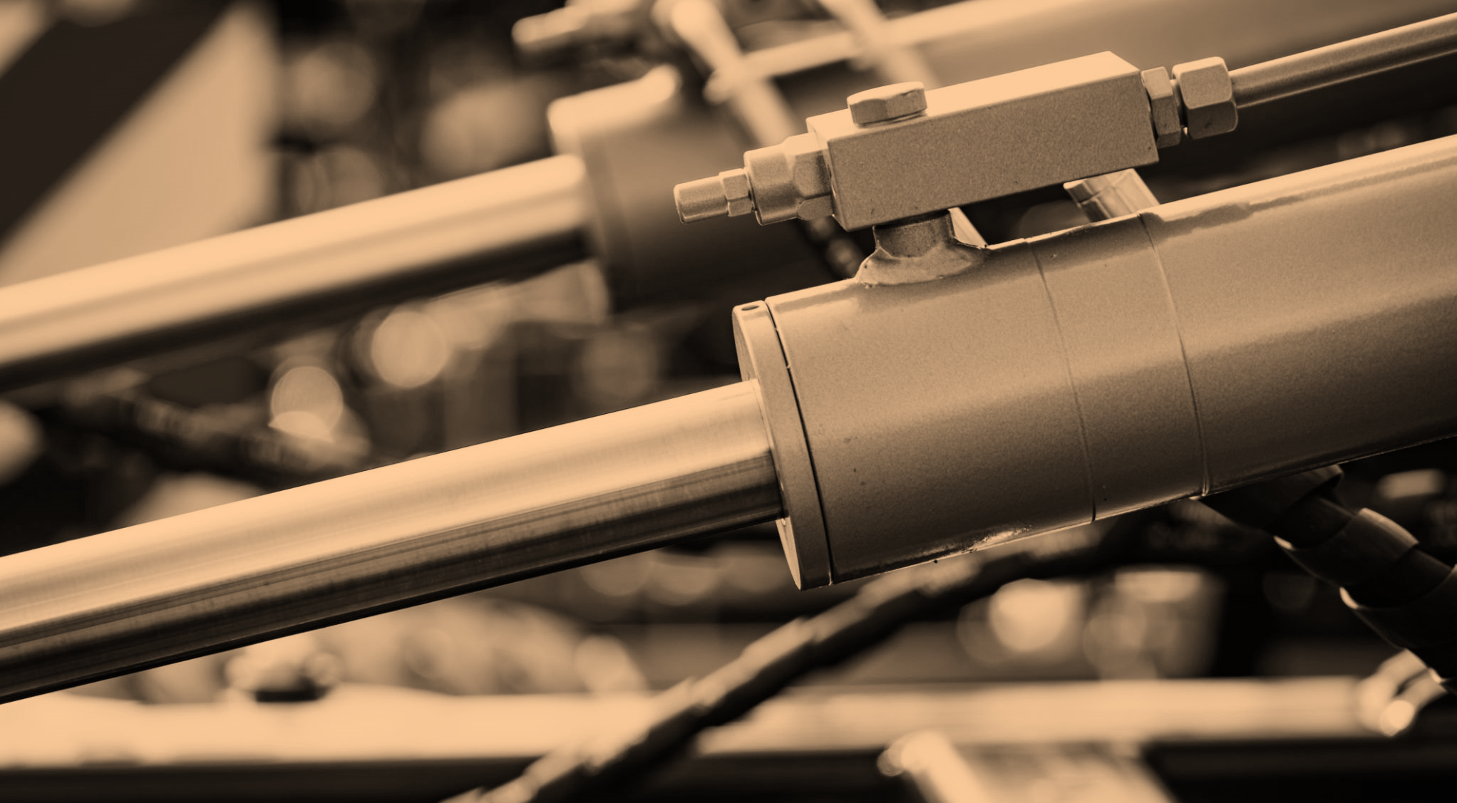
Key takeaways
ISO 4413/4414
and PSR 2000
Fishbone Diagrams
Hybrid Approach
Documentation & Continuous Improvement
45
Notes:
45

Slide 46

Thank you
Akbar Q
Mechatronics Engineering
46
Notes:
46

